Slide 1
Harry Potter’s Brands
Principali Product Placement nei film della saga del mago
www.dyspedia.com

Slide 2



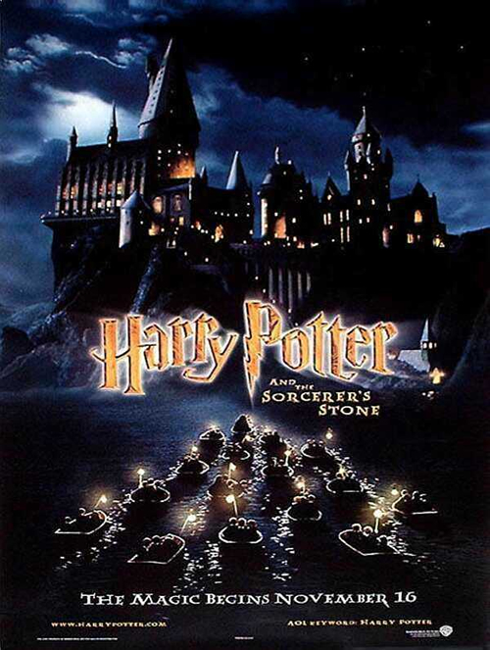






Slide 3




Slide 4


Nessun
Product placement
presente

Slide 5


Nessun
Product placement
presente

Slide 6






Slide 7


Nessun
Product placement
presente

Slide 8




